Slide 1
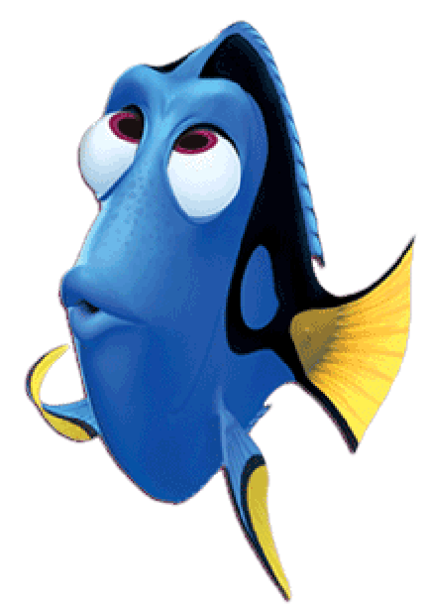
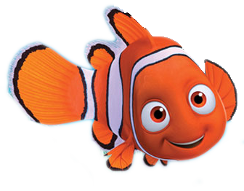
Can you help me find my friend Dory?

Slide 2
Want to know a secret?

Slide 3
Dory likes red squares.

Slide 4
Which one is the red square?

Slide 5
GREAT JOB!

Slide 6
What color is the other square?

Slide 7
Let’s find all of the red squares!

Slide 8
Can you help me find my friend Dory?

Slide 9
Want to know a secret?

Slide 10
Dory likes black squares.

Slide 11
Which one is the black square?

Slide 12
GREAT JOB!

Slide 13
What color is the other square?

Slide 14
Let’s find all of the black squares!

